Slide 1
Digital Watermarking of Videos
By:
Rishita Vaghela
Jruvika Bhimani
Neha Jangale
Under Guidance of:
Prof. Mrs. Swati Deshpande

Slide 2
Digital Watermark of Videos
Embedding watermark image into video to verify authenticity of the owner.
Types of watermark
Invisible watermark.
Visible watermark.
Watermarking Domain:
Spatial Domain.
Frequency Domain.

Slide 3
Proposed Algorithm
Invisible watermark : Making subtle changes to original content which are imperceptible to HVS.
Working Domain : Spatial domain
Watermark embedded by modifying the pixel values of the host image/video directly.

Slide 4
Properties & Requirements
Properties :
Robustness
Imperceptibility
Security
Requirements :
Hardware Requirements:
1GB external graphic card.
Software Requirements:
Windows based having version 2000 or above.
MATLAB 2009 or above.

Slide 5
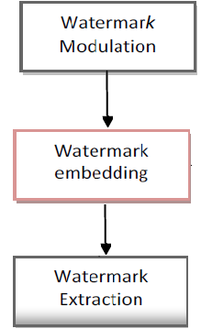
Algorithm
Scheme is composed of three main components:
Watermark Modulation
Watermark Embedding
Watermark Extraction

Slide 6
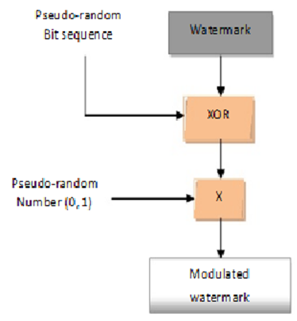
Watermark Modulation
Watermark L= [l1, 12,..,lN] ; li Є {0, 1}
is a bit sequence of length N.
Watermark is modulated by XOR operation containing pseudo-random bit sequence :
s = [s1, s2,…, sN] ; si Є {0, 1}
which is multiplied by another
pseudo-number sequence (0, 1) to
provide modulated watermark
sequence
W = [w1, w2,…, wN]

Slide 7
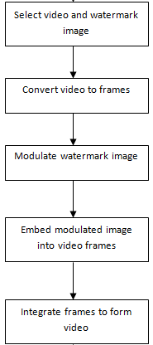
Embedding Watermark into Videos
Convert file into frames and modulate the watermark image.
Apply watermarking algorithm.
Again convert frames into video.

Slide 8

Watermark Embedding Process
Before the embedding process the host frame is decomposed into n×n blocks.
Embedding Procedure :
Calculate mean, max & min values of block.
Find values above and below mean value of that block.
Calculate mean values of blocks below mean and above mean value.
Calculate new pixels values V` according to the following :
Inserted bit 0
If V < mlow then
V’ = Vmin
Else If Vmean < V < mhigh then
V’ = Vmean
Else
V’ = V-a
Inserted bit > 0
If V > mhigh then
V’ = Vmax
Else If mlow < V < Vmean then
V’ = Vmean
Else
V’ = V+a.
Finally the original frame is replaced with the resulting watermarked frame.

Slide 9
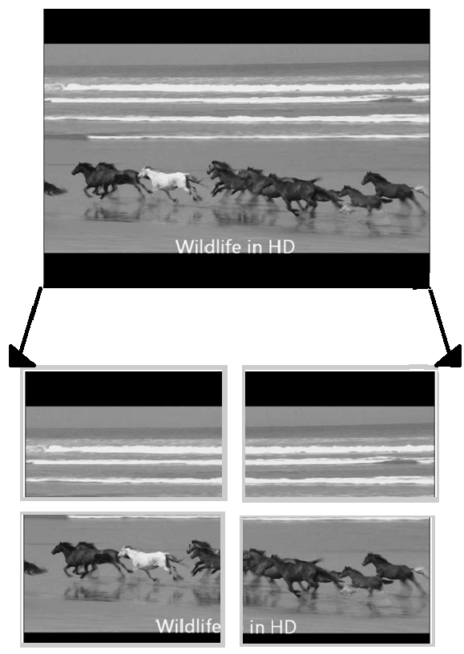
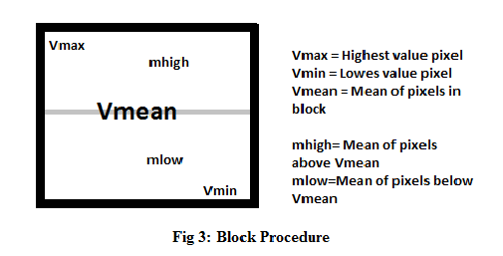
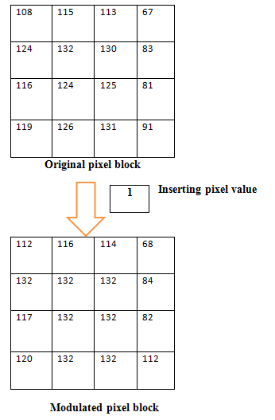
Block Processing

Slide 10
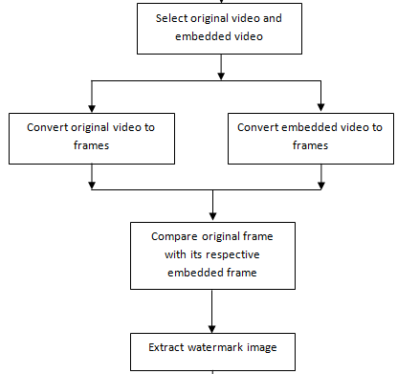
Extracting Watermark from Videos
Each frame is divided into same block size
used during embedding.
Summation of each block of the original
frame n the modulated frame is taken.
Now,
if sum(modulated block) >
sum(original block)
extracted bit = 1;
else
extracted bit = 0;
The extracted bits are then again XORed with the same pseudo random number with same passkey to get back the original image.

Slide 11
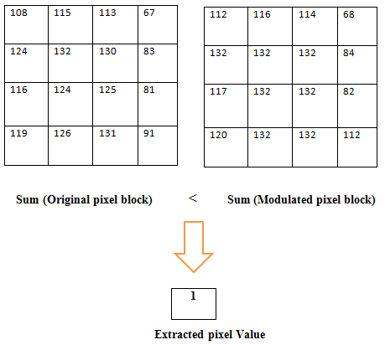
Actual Processing
During Embedding
During Extraction

Slide 12
Geometric Attacks
The proposed algorithm is Robust against the following attacks:
Rotation
Scaling
Translation
Cropping

Slide 13
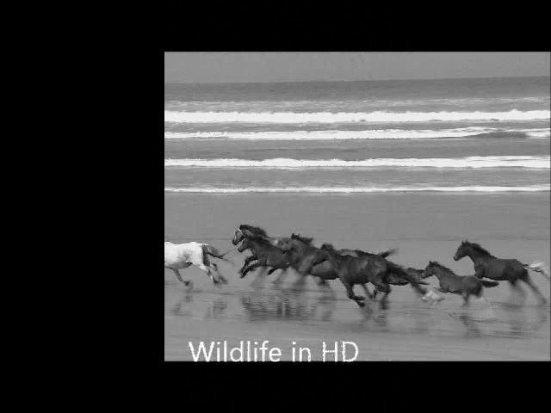
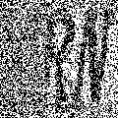
Cropping Attack
Cropped Frame
Extracted Watermark
The above illustration shows that the proposed algorithm is robust against cropping attack.

Slide 14


Result And Analysis:
Measurement of Quality:
PSNR:
PSNR = dB
NC:
NC = 0.6834

Slide 15
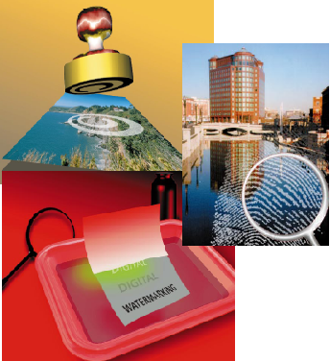
Applications
Copyright Protection
Authenticity
Secure & Invisible
Communication
Notes:
Copyright protection : Potential Markets:Electronic Commerce.Distribution of Multimedia Content.Digital Libraries.Audio & DVD protection.
Authenitcity:Movies, video clips etc could be watermarked.The watermarks, which might be detected automatically, could provide proof of authenticity.
Forensic applications.
Secure n invi commn: Could have wide range of applications in defense & Intelligence Sector.

Slide 16
Thank You

